Slide 1

Team Name
Institute Name
1 (Leader)
Team Noobz
IIT Guwahati
2
3
4
Kartik Bansal
Debarshi Chanda
Manan Kakkar
Kashyap Agarwal
2022
2023
2023
2024

Slide 2
USP of the Product
Solution
1
Healthcare not available to masses due to cost.
1
Digital detection and solutions will reduce the cost drastically.
2
Travel issues with elder people.
Problems
2
Checkup and medicine at doorstep
3
Digital solutions will enable more doctors in R&D sector
3
Less doctor to patient ratio.

Slide 3
Specification 1 : Skin disease detection
High
Skin Disease Detection
We apply Deep Learning models to detect skin disease via uploading images or webcam.
Healthcare Cost
Remedy
On the spot cure of the disease. Digitalization in the health sector is the need of the hour.
1
Medication
We can also step our foot in medication sector by providing them medicines of the disease via B2B or B2C.
Low
Innovation
High
High
1 represents our idea
Medium
Low

Slide 4



Specification 2 : Sound mental health
Key Features
Depression Cure – In U.S nearly every elder citizen lives alone. Loneliness paves path for depression. So making a peer group with similar interest, disease and age group will surely affect their mental health in a positive way.
Physical Benefits – We have weekly tasks such as whole group must do camping or playing tennis, doing Tai chi to earn reward points for healthcare. This way they can be physically sound as well.
Infinite Reach – We can ask them to upload the photos doing their task. These photos can be posted via our social media channel which will increase our reach as well as spread awareness among the people towards healthcare.

Slide 5

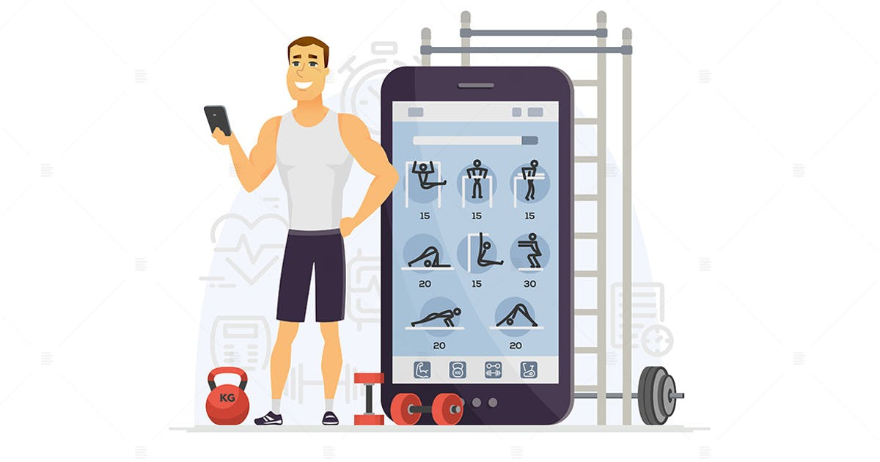
Specification 3 : Online consultation, checkup and physical fitness.
Features
Pricing
Online Consultation:
Consult with your choice’s doctor on basis of feedback and type.
Order medicine online
Criteria:
Monthly or yearly subscription plan
Extra benefits to premium customer
Extra
2 Doctor consultation free then charges will apply
Checkup:
Checkup at doorstep
Time as per patient’s convenience
Key Benefits
Every healthcare benefits at your doorstep
Everything in one place (app)
Improve customer base
Exercise App:
Exercise and diet according to disease prescribed by doctor
Music enabled app
Reward points for time of training which will increase the revenue from advertisement

Slide 6

Specification 4 : Disease detector by symptoms
Key Insights
“Excel”
Hassle free detection
Takes less time and prevent visiting to doctor for detectable diseases and cure.
99%
Ask symptoms from patients unless 99% match with disease.
1.
Suggest online consultation if less confidence interval for disease or according to severity of disease.
Extra Income Base
Doorstep medicine and more subscription to our app.
2.
3.
Treating the poor
A large section of society cannot use the healthcare facilities due to lack of money but this will help them a lot.
Suggest possible cure for the disease and recommend our medication supply.

Slide 7

Conclusion
Success
Optum rocks
Testing the software on limited user base
Get the feedback
Implementing model
Creating model
Developing the software to digitalize healthcare

